Slide 1

Polymorphism
Prepared by:
Raj Prasad Shrestha
Lecturer/Tutor at HCK

Slide 2
Review of Previous Week
Concept of inheritance
The super keyword
The is-a and has-a relationship
The extends keyword
The instanceof keyword
Types of inheritance
Advantages of inheritance

Slide 3
Agenda
What is Polymorphism?
• Method Overriding (Run time Polymorphism)
• Method Overloading (Compile time Polymorphism)
• Abstract Methods and Classes
• Inheriting Abstract Class
• Object Equality

Slide 4
What is Polymorphism?
Poly means ‘many’ and morph means ‘form’.
Polymorphism is the ability of an entity(object) to take several forms.
Similarly, in the programming world, Java objects possess the same functionality where each object can take multiple forms.

Slide 5

Ref: https://www.edureka.co/blog/polymorphism-in-java/

Slide 6
Polymorphism in Java
In Java, there are two types of polymorphism they are:
      1) Compile time Polymorphism(Early Binding)
      Run time Polymorphism( Late Binding)
At compile time , it will know which version of method should be called(or bind with) is known as compile time polymorphism. Constructor and Method overloading is an example of compile time polymorphism.
At runtime , it will know which overridden method is to called (or bind with) is called runtime polymorphism.
Method overriding is an example of run time polymorphism.

Slide 7
Method Overloading
If a class have multiple methods by same name but different parameters, it is known as Method Overloading.
Advantages of Method Overloading:
If we have to perform only one operation, having same name of the methods increases the readability of the program.

Slide 8
Method Overloading
Rules to Overload the method:
1. By changing number of parameters(arguments)
2. By changing the data type of parameters
Note: In java, Method Overloading is not possible by changing the return type of the method

Slide 9
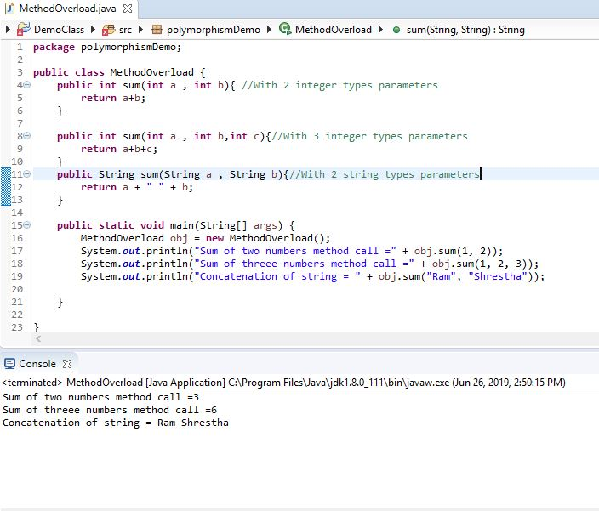
Method Overloading Examples
Same method name (.i.e sum) with different parameters in a class named MethodOverload

Slide 10
Method Overriding
If subclass (child class) has the same method as declared in the superclass( parent class), it is known as method overriding in java.
Usage of Overriding:
Overriding is a feature that allows a subclass or child class to provide a specific implementation of a method that is already provided by one of its super-classes or parent classes.

Slide 11
Method Overriding
Rules for Java Method Overriding:
1. Classes must be IS-A relationship (inheritance).
2. Method must have same name as in the parent class.
3. Method must have same parameter as in the parent class.

Slide 12
Method Overriding
Bank bank ;
This statement says that bank is a reference variable of type class Bank
bank = new NicAsia();
This statement says that bank as a reference variable and it refers to NicAsia class object

Slide 13
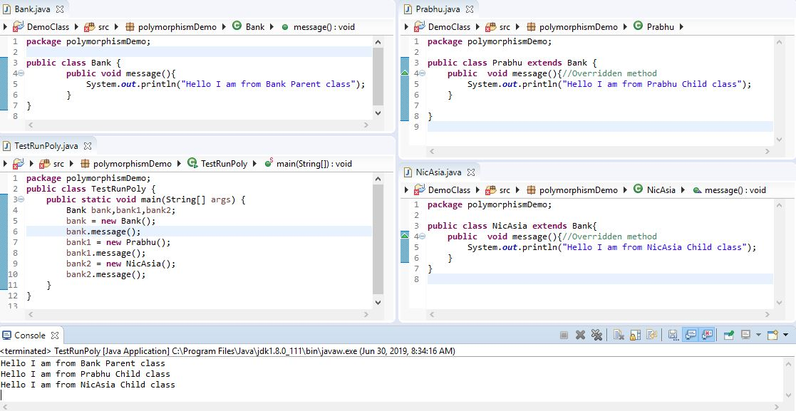
Method Overriding Examples
SuperClass
Subclass
Testclass
Subclass
Same method signature in Superclass and Subclasses with different implementations

Slide 14
Abstraction
Java Abstraction whose main functionality is to hide the internal implementation details.
It basically deals with hiding the internal details and showing the essential things to the user.

Slide 15

Abstraction
Ref: https://www.edureka.co/blog/java-abstraction/

Slide 16
Achieving Abstraction in Java
You can achieve abstraction in two ways:
1. Abstract Class
2. Interface

Slide 17
Abstract Class
Abstract class contains the ‘abstract’ keyword.
If you make the class abstract, it cannot be instantiated, i.e you cannot create an object of an abstract class.
Also, an abstract class can contain abstract as well as concrete(normal) methods.
Abstract method:
A method that is declared as abstract and does not have implementation(no body)is known as abstract method.

Slide 18
Syntax of Abstract Class and Method
Abstract Class Syntax:
abstract class ClassName
{
//Instance variables ,Abstract and Normal methods
}
2. Abstract Method Syntax:
abstract return_type methodName;
Note: that the method signatures have no braces and are terminated with a semicolon.(Abstract method)
Note: You can achieve 0-100% abstraction using an abstract class.

Slide 19
Inheriting Abstract Class
Subclass can inherit abstract and concrete(normal) methods from Superclass Abstract class.
Subclass override the abstract methods of Superclass abstract class.
Note: Abstract methods override by Subclasses should have the method definition(in Subclass).

Slide 20
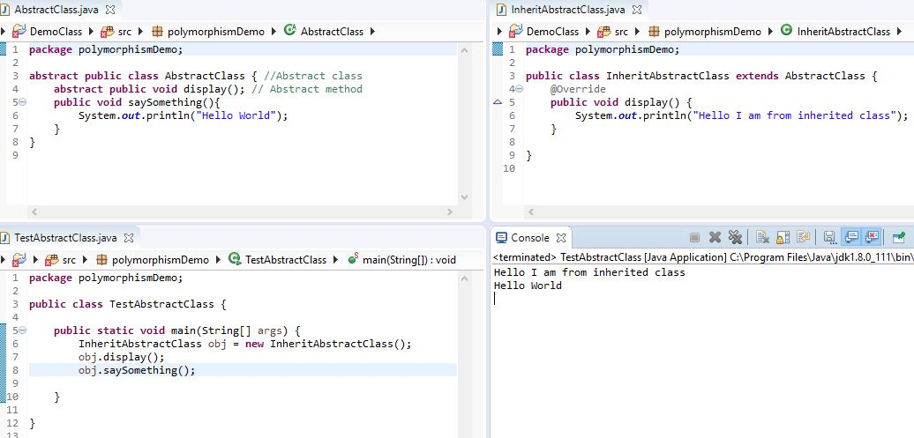
Example of Inheriting Abstract Class
Subclass inherit abstract method from Superclass with its definition
Superclass declared as abstract
Abstract method
Test class

Slide 21
Object Equality and hashCode
In java equals() method is used to compare equality of two Objects.
Hashcode is a number generated from any object. This is what allows objects to be stored/retrieved quickly in a Hashtable.

Slide 22
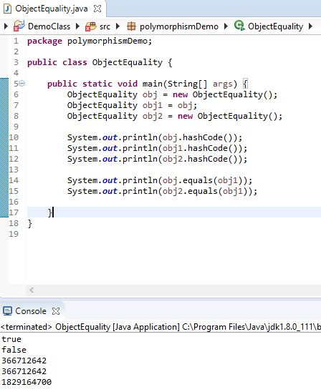
Object Equality and hashCode Demo

Slide 23
References
  https://goalkicker.com/JavaBook/
  https://www.edureka.co/blog/polymorphism-in-java/
  https://docs.oracle.com/javase/tutorial/java/IandI/polymorphism.html
  https://www.geeksforgeeks.org/equals-hashcode-methods-java/
  https://dzone.com/articles/object-identity-and-equality-in-java
  https://www.youtube.com/watch?v=bn3zKuU6gwI&list=PLGwb7xZHg-oMzLwqeyvdI7R_OWVMQFyce

